Slide 1
CS4100: Computer Architecture Instructions: Language of the Computer (I)
Prof. Chung-Ta King
Department of Computer Science
National Tsing Hua University, Taiwan
(Adapted from textbook slides https://www.elsevier.com/books-and-journals/book-companion/9780128122754/lecture-slides)

Slide 2
Introduction
To command a computer, you must speak its language
Most computers understand high-level languages (HLL), e.g., C, C++, Java, with suitable compilers
How about language to a computer’s hardware?
Assembly language ➔ machine instructions
Very close to control signals to control hardware operations
foo(int v[], int k) {
int temp;
temp = v[k];
v[k] = v[k]+v[k+1];
v[k+1] = temp;
}
Variables (memory locations storing date)
operands of operators
Operators
operations on operands

Slide 3
Outline
Languages of computers (Sec. 2.1)
Operations of computer hardware (Sec. 2.2)
Operands of computer hardware (Sec. 2.3, 2.4)
Registers, memory, signed and unsigned numbers
Representing instructions (Sec. 2.5)
More operations: logic, decision making (Sec. 2.6, 2.7)
Supporting procedures in hardware (Sec. 2.8)
More operand representations (Sec. 2.9, 2.10)
Characters, wide immediates and addresses
Parallelism and instructions (Sec. 2.11)
Translating and starting a program (Sec. 2.12)

Slide 4
Outline
A C sort example to put it all together (Sec. 2.13)
Arrays versus pointers (Sec. 2.14)
Compiling C and interpreting Java (Sec. 2.15)
Other ISAs: MIPS, x86 (Sec. 2.16, 2.17)
The rest of RISC-V (Sec. 2.18)
Fallacies and pitfalls (Sec. 2.19)

Slide 5
Outline
Languages of computers (Sec. 2.1)
Operations of computer hardware (Sec. 2.2)
Operands of computer hardware (Sec. 2.3, 2.4)
Registers, memory, signed and unsigned numbers
Representing instructions (Sec. 2.5)
More operations: logic, decision making (Sec. 2.6, 2.7)
Supporting procedures in hardware (Sec. 2.8)
More operand representations (Sec. 2.9, 2.10)
Characters, wide immediates and addresses
Parallelism and instructions (Sec. 2.11)
Translating and starting a program (Sec. 2.12)

Slide 6
Language to Computer Hardware
Control
Register
Datapath
0111
Control signals
Memory
0011
0100
Controller
10110100
01001101
ALU
+
N
Z
clock
10110100
IR
01001101
PC
add r1,r2,r3
Instruction: words of a computer’s language
Instruction set: vocabulary of the language
Notes:
0s and 1s in the instructions become signals to control the datapath

Slide 7
Language to Computer Hardware
Different computers have different languages (instruction sets)
But with many aspects in common
Because all computers are constructed from hardware technologies based on similar underlying principles
Because there are a few basic operations that all computers must provide
Makes it easy to build the hardware and the compiler while maximizing performance and minimizing cost and energy
Combinations of these basic operations allow a computer to run all sorts of programs written in various HLLs
What are the most basic operations and how to specify them?
Notes:
What must a food processor have in order to make all kinds of cooking?

Slide 8
Essentially, We Are Asking …
What must be specified in an instruction set architecture (ISA)?
“ISA encompasses all the information necessary to write a machine language program that will run correctly”
Including:
operations: +, -, *, /, ...
operands (data, address)
flow control
Application
Compiler
Operating System
SW
Assembler
ISA
What are included in ISA and how are they specified have profound effects on computer design!
HW
Processor
Memory
I/O System
Datapath & Control
Digital Design
Circuit Design
Transistors

Slide 9
Components of an ISA
Storage and data: (operands)
Organization of programmable storage:
Registers: # of bits, # of registers, their roles, …
Memory: addressing, access methods, …
Data types and data structures
Integers, floating-point, text, signed number, …
Operations on data and execution flow control:
Instruction set (or operation code)
ALU, control transfer, exceptional handling
Instruction specification:
Instruction format and encoding

Slide 10
Use 64-bit RISC-V (RV64) as an Example
Developed at UC Berkeley as open ISA
Now managed by the RISC-V Foundation (riscv.org)
Typical of many modern ISAs
Similar ISAs have a large share of embedded core market
Applications in consumer electronics, network/storage equipment, cameras, printers, …
We will not only describe what the RISC-V ISA is
But also study the principles behind the design
And examine some different design options to appreciate why RISC-V chooses the specific option

Slide 11
Outline
Languages of computers (Sec. 2.1)
Operations of computer hardware (Sec. 2.2)
Operands of computer hardware (Sec. 2.3, 2.4)
Registers, memory, signed and unsigned numbers
Representing instructions (Sec. 2.5)
More operations: logic, decision making (Sec. 2.6, 2.7)
Supporting procedures in hardware (Sec. 2.8)
More operand representations (Sec. 2.9, 2.10)
Characters, wide immediates and addresses
Parallelism and instructions (Sec. 2.11)
Translating and starting a program (Sec. 2.12)

Slide 12
What Basic Operations for Hardware?
Operations to work on data
Arithmetic (+, -, *, /), logic (&, |, ~) → similar to a function, e.g. z=f(x,y), operating on values
2-operand (a + b), 1-operand (++a)
Operations to move and copy data between storage locations
As storage, original location still retains the data, until explicitly overwritten
Operations to change execution flow
Unconditional: goto, jump to new location to execute
Conditional: if-then-else, jump if condition is true
Procedural: foo(), similar to goto but need to come back

Slide 13
Let’s Start with Arithmetic Operations
The most basic operation for any computer hardware is arithmetic operation on numbers, e.g., a = b + c
Basic RISC-V arithmetic instructions are specified as:
add a,b,c # a ← b + c
All RISC-V arithmetic instructions have this form
3-address: a, b, c are storage locations that hold data, but c may also be a value
Why storage concept indispensable?
Design Principle 1: Simplicity favors regularity
Regularity makes implementation simpler
Simplicity enables higher performance at lower cost
vs. Flexibility

Slide 14
Arithmetic Instruction Example
C code:
f = (g + h) - (i + j);
Compiled RISC-V (pseudo) code:
add t0, g, h # temp t0 ← g + h add t1, i, j # temp t1 ← i + j sub f, t0, t1 # f ← t0 - t1
t0 and t1 are temporary variables, i.e., storage locations, normally allocated by the compiler

Slide 15
Why 3-Address Format: add a,b,c?
Why not 2-address format? add b,c # b ← b + c
Still regular, and one address less to specify and encode!
How about 0-address format? add
Where to get the operands?
➔ must be specified implicitly so that the computer hardware knows where to get, e.g. in a stack add #stack[top]←stack[top]+stack[next]
Tradeoff between flexibility and complexity

Slide 16
Outline
Languages of computers (Sec. 2.1)
Operations of computer hardware (Sec. 2.2)
Operands of computer hardware (Sec. 2.3, 2.4)
Registers, memory, signed and unsigned numbers
Representing instructions (Sec. 2.5)
More operations: logic, decision making (Sec. 2.6, 2.7)
Supporting procedures in hardware (Sec. 2.8)
More operand representations (Sec. 2.9, 2.10)
Characters, wide immediates and addresses
Parallelism and instructions (Sec. 2.11)
Translating and starting a program (Sec. 2.12)

Slide 17
Operands to an Operation
Operands may be the value itself (immdiates) add a,b,3 or the storage location holding the value add a,b,c
The storages that can hold values may be in memory or in registers
Registers are a small number of storage locations built directly into CPU hardware; memory refers to storage locations in the main memory ➔ need to specify addresses
How about disk? Why not disk locations as operands?
RISC-V arithmetic instructions must use register operands!
3
2
1

Slide 18
Why Restricted to Register Operands?
Why not allow memory operands, too? add M[1000],M[2019],M[2020]
Registers are inside CPU → same clock as CPU, connect directly to arithmetic units, short and fast signals
Registers are small → easy to activate to access data, short and fast signals
Registers are small → fewer number of bits to specify and encode ➔ smaller instructions
Suitable for holding frequently accessed data
Design Principle 2: Smaller is faster
Register vs. main memory (millions of locations)

Slide 19
How to Specify (1) Register Operands?
Must know RISC-V register organization!
RISC-V has a 32 × 64-bit register file
32 registers specified as x0 to x30, each with a 5-bit addr
doubleword
x0 constant 0 | x10 x11
x1 return address
x2 stack pointer
x3 global pointer
x4 thread pointer | x18 saved registers x27
x8 frame pointer
x9 saved registers
function arguments/results
x12
…
function arguments
x17
x5
…
Why not 64, or 16?
…
temporaries
x7
x28
…
temporaries
x31
Notes:
Why not 64? Small is fast! Number of bits for encoding an instruction.

Slide 20

Register Operand Example
How to do the following C statement?
f = (g + h) - (i + j);
Assume that f, g, h, i, j are in x19, x20, x21, x22, x23
Use intermediate temporary registers x5, x6
add x5,x20,x21 # x5 ← g + h
add x6,x22,x23 # x6 ← i + j
sub x19,x5,x6 # f ← x5 – x6
If data are in the memory, they must be loaded into the registers first before arithmetic operations can be operated on them; after operations, they need to be stored back
Use data transfer instructions (ld, sd, ...) discussed later
Notes:
Why not get rid of memory altogether?

Slide 21

How to Specify (2) Memory Operands?
Must know RISC-V memory organization!
Main memory is organized as a 1D array of locations
Each location can hold one byte of data and is identified by an address → memory is byte addressed, i.e. each address identifies an 8-bit byte of data, ranging from 0 to 2⁶¹
A nature way of specifying memory operands in RISC-V is like addressing an array, e.g., A[100]
A is the base address and 100 is the offset and memory address of A[100] is (A + 100)
In RISC-V, memory operand is specified as: 100(x22), where x22 contains base addr. and 100 is offset (in bytes)
A memory operand normally gets a doubleword (64 bits), and thus word addresses differ by 8
Notes:
Why not word-addressed?

Slide 22
Memory Operand Example
C code:
A[9] = h + A[8];
h in x21, base address of A in x22
A[8]: the 8th doubleword in array A[], which is at the 64th byte from start of A[]
Compiled RISC-V code:
ld x9, 64(x22) add x9, x21, x9 sd x9, 72(x22)
2⁶⁴ - 1
…
A[9] = 1096
A[8] = 1088
…
load doubleword
A = 1024
…
0
store doubleword
offset
base register

Slide 23
Registers and Memory Size
64 bit address | data
0x 0000 0000 0000 0000
0x 0000 0000 0000 0001
0x 0000 0000 0000 0002
0x 0000 0000 0000 0003
0x 0000 0000 0000 0004
0x 0000 0000 0000 0005
0x 0000 0000 0000 0006
0x 0000 0000 0000 0007
…
0x FFFF FFFF FFFF FFFF
Memory
RISC-V I64 CPU
x0 | 0
x1
x2
…
x31
double word
=64 bits
double word=64 bits
5 bits for register ID
Note: actual physical address bits are less than 64, e.g., 42 for Intel x86_64
(Prof. Jing-Jia Liou)
1byte=8bits

Slide 24
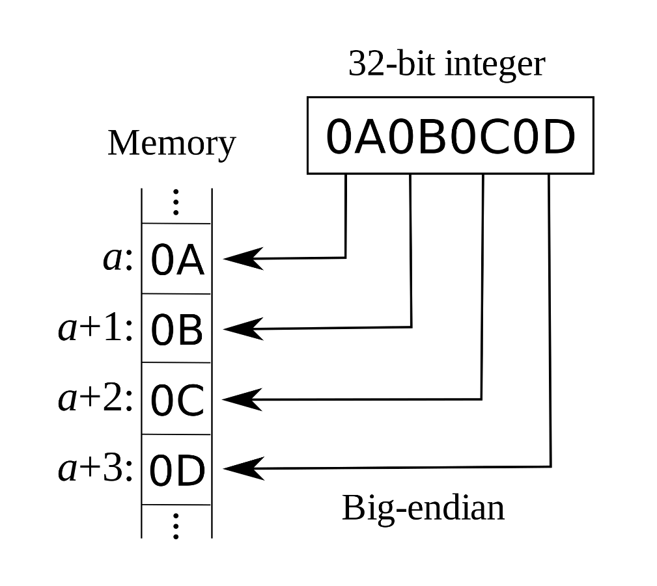
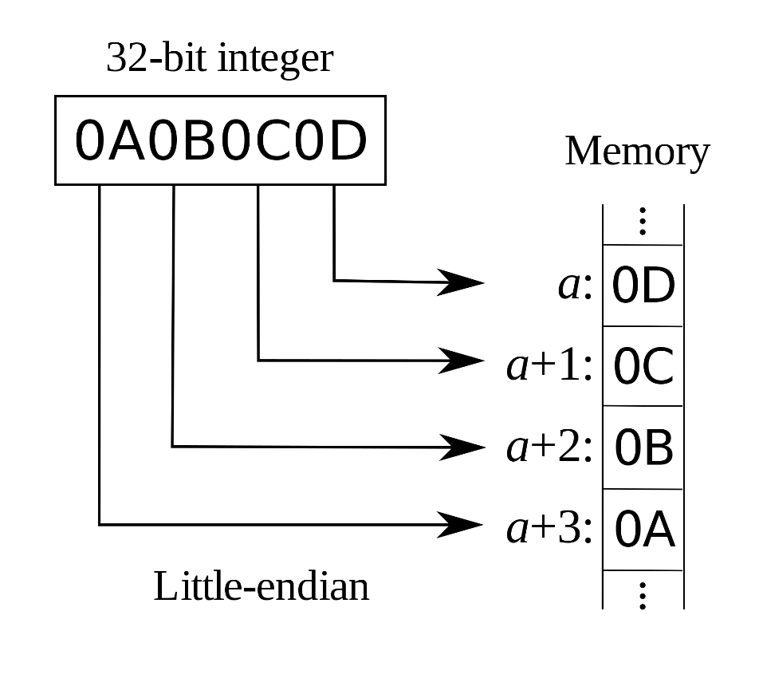
More about RISC-V Memory Organization
RISC-V is Little Endian
Least-significant byte at least address of a word
c.f. Big Endian: most-significant byte at least address
(By R. S. Shaw - Own work, Public Domain, https://commons.wikimedia.org/w/index.php?curid=2974661)

Slide 25

More about RISC-V Memory Organization
RISC-V does not require words to be aligned in memory, i.e., at an address a multiple of 4 (for a word) or 8 (for a doubleword)
Unlike some other ISAs; but misaligned memory accesses may be very very slow
2⁶⁴ - 1
…
0 1 2 3
Not
Aligned
A[9] = 1096
Aligned
Not
Aligned
Aligned
A[8] = 1088
…
A = 1024
…
0
Notes:
Why need to aligned?

Slide 26
Registers vs. Memory
Registers are faster to access than memory
But, operating on memory data requires loads and stores
More instructions to be executed, larger code size
Compilers should use registers for variables as much as possible
Only spill to memory for less frequently used variables, if more variables than available registers are used
Register optimization is important!
Why not keep all variables in memory?
Smaller is faster: registers are faster than memory
Registers are more versatile:
Register file can read 2 and write 1 registers per instruction
Memory read/write 1 operand per instruction, no operation

Slide 27

How about (3) Immediate Operands?
Small constants used frequently (50% of operands) e.g., A = B + 4; if (C > 1) … ;
Put 'typical constants' in memory and load them
ld x9, AddrConstant4(x3)
add x22, x22, x9
Alternative: constant data specified in the instruction addi x22, x22, 8
Too slow
Immediate operand
Design Principle 3: Make the common case fast
Small constants are common
Immediate operand avoids a load instruction
Why define a new instruction, addi? Why not reuse add?

Slide 28
Handling Constant Zero and Negatives
The number zero (0) is so common in code that RISC-V hardwired register 0 (x0) to 0
Cannot be overwritten, e.g., addi x0,x0,5 (no effect)
Useful for other common operations, too, e.g., move between registers: add x22, x20, x0
Thus, there is no need to implement a move instruction in hardware → simpler CPU design and implementation
No need for subtract immediate instruction either
Just use a negative constant: addi x22, x22, -8
Time to review signed and unsigned numbers

Slide 29
Represent Unsigned Binary Integers
Given an n-bit number
Use all the bits to represent values
Example: (32 bits)
0000 0000 0000 0000 0000 0000 0000 1011₂ = 0 + … + 1×2³ + 0×2² +1×2¹ +1×2⁰ = 0 + … + 8 + 0 + 2 + 1 = 11₁₀
Range: 0 to +2^{n} – 1
Using 32 bits: 0 to +4,294,967,295
Using 64 bits: 0 to +18,446,774,073,709,551,615
…
Can get the max value

Slide 30
Signed Binary Integers (2’s-Complement)
Given an n-bit number
Use bit 31/63 to represent sign (sign bit)
1 for negative and 0 for non-negative numbers
Signed negation: complement (1 → 0, 0 → 1) & add 1
Non-negative numbers have the same representation
–(–2^{n – 1}) can’t be represented
Example: (32 bits)
1111 1111 1111 1111 1111 1111 1111 1100₂ = –1×2³¹ + 1×2³⁰ + … + 1×2² +0×2¹ +0×2⁰ = –2,147,483,648 + 2,147,483,644 = –4₁₀
…
Notes:
The negation or complement of a number x is 2^n − x, or its “two’s complement.”

Slide 31
2’s-Complement Signed Integers
Range: –2^{n – 1} to +2^{n – 1} – 1
Using 32 bits: –2,147,483,648 to +2,147,483,647
Using 64 bits: −9,223,372,036,854,775,808 (1000 … 0000₂) to 9,223,372,036,854,775,807 (0111 1111 … 1111₂)
0: 0000 0000 … 0000₂
–1: 1111 1111 … 1111₂ (least negative number)
Most-negative number (1000 … 0000₂) does not have a corresponding positive number
Why 2’s complement?
One adder, no distinction
Signed/unsigned +/- treated the same!
SW interprets meaning
Notes:
Sign bits can be manipulated in the same way as value bits → unsigned and signed number additions can be done by the same adder hardware; there is no need to distinguish which is which

Slide 32
Sign Extension
Representing a number using more bits while preserving the numeric value
How to do? replicate the sign bit to the left
c.f. unsigned values: extend with 0s
Examples: 8-bit to 16-bit
+2: 0000 0010 ➔ 0000 0000 0000 0010
–2: 1111 1110 ➔ 1111 1111 1111 1110
In RISC-V instruction set
lb: load byte (sign-extend loaded byte)
lbu: load byte unsigned (zero-extend loaded byte)
Sign?
lb x22,0(x21)
FFFFFF
F7
lbu x22,0(x21)
000000
F7
Notes:
What matters is how software interprets the bits

Slide 33
Outline
Languages of computers (Sec. 2.1)
Operations of computer hardware (Sec. 2.2)
Operands of computer hardware (Sec. 2.3, 2.4)
Registers, memory, signed and unsigned numbers
Representing instructions (Sec. 2.5)
More operations: logic, decision making (Sec. 2.6, 2.7)
Supporting procedures in hardware (Sec. 2.8)
More operand representations (Sec. 2.9, 2.10)
Characters, wide immediates and addresses
Parallelism and instructions (Sec. 2.11)
Translating and starting a program (Sec. 2.12)

Slide 34
How to Specify RISC-V Instructions?
Now that we have learned operations and operands of computer hardware, let us study how to put them together to form computer instructions
Remember: Computer only understands 1s and 0s, so “add x21,x22,x23” is meaningless to hardware
Instructions to instruct computer hardware how to operate should also be encoded in binary, called machine code
RISC-V’s strategies for instruction encoding
Encode every instruction in 32-bit words, divided into fields
Small number of formats encoding operation code (opcode), register numbers, …
Let’s look at three of them first
Regularity!
Why not just 1 format?

Slide 35
RISC-V R-format Instructions
For register to register operations
Instruction fields
opcode: operation code
rd: destination register number
funct3: 3-bit function code (additional opcode)
rs1: the first source register number
rs2: the second source register number
funct7: 7-bit function code (additional opcode)
funct7
rs2
rs1
funct3
rd
opcode
7 bits
5 bits
5 bits
3 bits
5 bits
7 bits
Why not combine op and funct?
Notes:
Question: Why aren’t opcode and funct a single 12-bit field?

Slide 36
R-format Example
funct7
rs2
rs1
funct3
rd
opcode
7 bits
5 bits
5 bits
3 bits
5 bits
7 bits
add x9,x20,x21
0
x21
x20
0
x9
add
0
21
20
0
9
51
0000000
10101
10100
000
01001
0110011
0000 0001 0101 1010 0000 0100 1011 0011_{two} = 015A04B3₁₆

Slide 37
RISC-V I-format Instructions
Immediate arithmetic and load instructions
rs1: source or base address register number
immediate: constant operand, or byte offset to base addr
2’s-complement, sign extended, −2¹¹ to 2¹¹−1
immediate
rs1
funct3
rd
opcode
12 bits
5 bits
3 bits
5 bits
7 bits
Design Principle 3: Good design demands good compromises
Different formats complicate decoding, but allow 32-bit instructions uniformly
Keep formats as similar as possible (only 1 field differs)
Notes:
Particularly, op code is still at the same location and takes 6 bits

Slide 38
I-Format Example 1
RISC-V instruction:
addi x9,x22,-50
opcode = 19 (look up in RISC-V Manual)
rs1 = 22 (source operand register number)
rd = 9 (destination register number)
immediate = -50 (by default, this is decimal)
Decimal representation:
Binary representation:
-51
22
0
9
19
1111 1100 1101
10110
000
01001
0010011

Slide 39
I-Format Example 2
RISC-V instruction:
ld x9,120(x22)
opcode = 3 (look up in RISC-V Manual)
rs1 = 22 (base address register number)
rd = 9 (destination register number)
immediate = 120 (offset)
Decimal representation:
Binary representation:
120
22
3
9
3
0000 0111 1000
10110
011
01001
0000011

Slide 40
RISC-V S-format Instructions
Different immediate format for store instructions
rs1: base address register number
rs2: source operand register number
immediate: offset added to base address
Split so that rs1 and rs2 fields always in the same place
RISC-V instruction:
sd x9,120(x22)
imm[11:5]
rs2
rs1
funct3
imm[4:0]
opcode
7 bits
5 bits
5 bits
3 bits
5 bits
7 bits
120-1
9
22
3
120-2
35
0000011
01001
10110
011
11000
0100011
Notes:
120 = 0000 0111 1000

Slide 41
Key Computer Design Principles
Computer instructions represented as numbers
Program instructions can be stored at the same place as data (in memory) and be manipulated in the same way as data ➔ stored-program computer
Instructions and data look the same, just 0s and 1s
Differ only in how you interpret the bits
One consequence: everything addressed
Everything has a memory address: instructions, data
Both branches and jumps use these
One register keeps address of the instruction being executed: “Program Counter” (PC)
Register can hold any 64-bit value, (signed) int, address, etc.

Slide 42
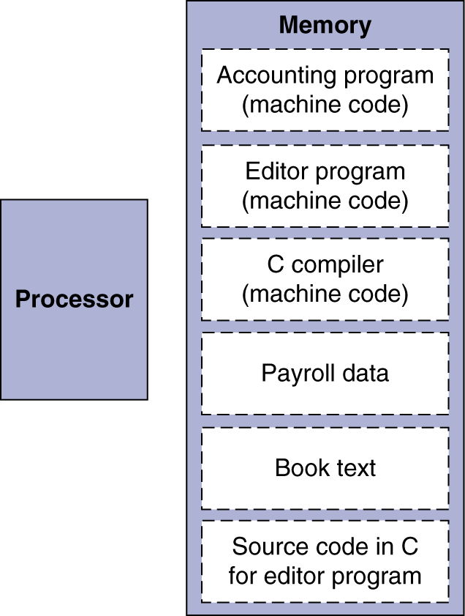
Stored-Program Computers
Consequence #2: programs can operate on programs
e.g., compilers, linkers, …
The latter is data to the former
Consequence #3: binary compatibility
Programs can be shipped as files of binary numbers and executed on any computers with a compatible ISA
Consequence #4: fast context switches of processes
Fig. 2.7
Notes:
Memory can contain the source code for an editor program, the corresponding compiled machine code, the text that the compiled program is using, and even the compiler that generated the machine code.

Slide 43
Stored Program with Memory Access
Memory
load
instr.
CPU
address | instruction/data
 | ld x20, 0(x10)
 | ld x21, 0(x11)
 | add x9, x20, x21
 | sd x9, 0(x12)
b | 10
c | 20
a | 30
 | …
Instruction Register
1
add x9, x20, x21
2
adder
10
1
3
20
4
2
30
3
(1) load b to x18=10
(2) load c to x19=20
(3) add x9=x18+x19
(4) store x9 to a
4
Assume
x10=b’s address
x11=c’s address
x12=a’s address
(Prof. Jing-Jia Liou)

Slide 44
Instruction and Data Encoding (in Hex)
Memory
CPU
Instruction Register
address | instruction/data
 | 00053A03₁₆
 | 0005BA83₁₆
 | 015A04B3₁₆
 | 00963023₁₆
b | 0000000A₁₆
c | 00000014₁₆
a | 0000001E₁₆
 | …
015A04B3₁₆
adder
0000000A₁₆
00000014₁₆
0000001E₁₆
Assume
x10=b’s address
x11=c’s address
x12=a’s address
(Prof. Jing-Jia Liou)

Slide 45
Outline
Languages of computers (Sec. 2.1)
Operations of computer hardware (Sec. 2.2)
Operands of computer hardware (Sec. 2.3, 2.4)
Registers, memory, signed and unsigned numbers
Representing instructions (Sec. 2.5)
More operations: logic, decision making (Sec. 2.6, 2.7)
Supporting procedures in hardware (Sec. 2.8)
More operand representations (Sec. 2.9, 2.10)
Characters, wide immediates and addresses
Parallelism and instructions (Sec. 2.11)
Translating and starting a program (Sec. 2.12)

Slide 46
Bitwise Operations
Up until now, we have seen arithmetic (add, addi) and memory access (ld, sd)
All of these instructions view contents of register as a single quantity (such as a signed or unsigned integer)
New perspective: View contents of register as 64 individual bits rather than as a single 64-bit number
Since registers are composed of 64 bits, we may want to access individual bits rather than the whole
Introduce two new classes of instructions:
Logical operators
Shift instructions

Slide 47
Logical and Shift Operations
Instructions for bitwise manipulation
Useful for extracting and inserting groups of bits in a word
Operation | C | Java | RISC-V
Shift left | << | << | sll, slli
Shift right | >> | >>> | srl, srli
Shift right arith. | >> | >> | sra, srai
Bitwise AND | & | & | and, andi
Bitwise OR | | | | | or, ori
Bitwise XOR | ^ | ^ | xor, xori
Bitwise NOT | ~ | ~
Fig. 2.8
Notes:
One way to implement NOT is to use XOR with one operand being all ones (0xFFFF FFFF FFFF FFFF).

Slide 48
Shift Operations
sll: shift left logical (R-type)
Shift left and fill with 0 bits
Shift left by i bits = multiplies by 2^{i} (faster than multiply)
Example: sll x9,x20,x21
x20 = 0000 … 0001; x21 = 0000 … 0011 = 3
After instruction executed, x9 will contain 0000 … 1000
funct7
rs2
rs1
funct3
rd
opcode
7 bits
5 bits
5 bits
3 bits
5 bits
7 bits
0
x21
x20
1
x9
sll
0000000
10101
10100
001
01001
0110011

Slide 49
Shift Operations
srl: shift right logical (R-type)
Shift right and fill with 0 bits
Shift right by i bits = divides by 2^{i} (unsigned only) (much faster than division, used in compiler optimization)
Example: srl x9,x20,x21
sra: shift right arithmetic (R-type)
Shift right and fill with sign bits (no sla!)
Shift right by i bits = divides by 2^{i} (signed)
Example: sra x9,x20,x21
x20 = 1111 … 1000; x21 = 0000 … 0011 = 3
After instruction executed, x9 will contain 1111 … 1111
0000000
10101
10100
101
01001
0110011
Note the encoding
0100000
10101
10100
101
01001
0110011

Slide 50
Shift Immediate Operations
slli: shift left logical immediate (32-bit RISC-V: RV32)
shamt: how many bits to shift
32-bit data can only be shifted 32 bit positions → 5-bit shamt
Same format as R-type, except rs2 becomes shamt
slli: how about 64-bit RISC-V (RV64)?
We can shift 64 bit positions and need 6 bits for shamt
How?
0000000
shamt
rs1
001
rd
0010011
7 bits
5 bits
5 bits
3 bits
5 bits
7 bits
000000
shamt
rs1
001
rd
0010011
6 bits
6 bits
5 bits
3 bits
5 bits
7 bits

Slide 51
Logic Operations
and: useful for setting certain portions of a word to 0s, while leaving the rest alone → masking
Example: and x9,x10,x11
or: useful for forcing certain bits of a word to 1s, while leaving others unchanged
Example: or x9,x10,x11
x10
00000000 00000000 00000000 00000000 00000000 00000000 00001101 11000000
x11
00000000 00000000 00000000 00000000 00000000 00000000 00111100 00000000
x9
00000000 00000000 00000000 00000000 00000000 00000000 00001100 00000000
x10
00000000 00000000 00000000 00000000 00000000 00000000 00001101 11000000
x11
00000000 00000000 00000000 00000000 00000000 00000000 00111100 00000000
x9
00000000 00000000 00000000 00000000 00000000 00000000 00111101 11000000

Slide 52
Logic Operations
XOR
0 | 0 | 0
0 | 1 | 1
1 | 0 | 1
1 | 1 | 0
xor: differencing operation
Set some bits to 1, leave others unchanged
xor x9,x10,x12
If mask (x12) = 1, 0 → 1 and 1 → 0
If mask (x12) = 1, 0 → 0 and 1 → 1
So, if mask is all 1s, XOR becomes a NOT operation → no need for a not instruction (2-address) in RISC-V
x10
00000000 00010100 00000000 00000000 00000000 00000000 00001101 11000000
x12
11111111 11000011 11111111 11111111 11111111 11111111 11111111 11111111
x9
11111111 11010111 11111111 11111111 11111111 11111111 11110010 00111111

Slide 53
So Far...
All instructions studied so far have allowed us to manipulate data
So we have built a calculator
However, in order to build a computer, we need the ability to make decisions and change the execution flow

Slide 54
Conditional Branch Operations
Branch to a labeled instruction if a condition is true
Otherwise, continue sequentially
beq rs1,rs2,L1
if (rs1 == rs2) branch to instruction labeled L1, i.e., load memory address of that instruction to PC (Program Counter), so that the CPU will next fetch and execute the branch-to instruction
bne rs1,rs2,L1
If (rs1 != rs2) branch to instruction labeled L1 by storing L1 (an address) into PC
Memory address

Slide 55
Compiling If Statements
C code:
if (i==j) f = g + h; else f = g - h;
f, g, h, i, j in x19, x20, x21, x22, x23
Compiled RISC-V code:
bne x22,x23,Else add x19,x20,x21 beq x0,x0,Exit // unconditional Else: sub x19,x20,x21 Exit: …
(true) i == j
(false) i != j
i == j?
Else:
f=g+h
f=g-h
Exit:
Why not unconditional jump?
Assembler calculates address
(discussed later)
Notes:
Encoding will be discussed in later chapter

Slide 56
Compiling Loop Statements
C code:
while (save[i] == k) i += 1;
i in x22, k in x24, base address of save[] in x25
Compiled RISC-V code:
Loop: slli x10,x22,3 // x10←i*8 add x10,x10,x25 // x10←save[i] ld x9,0(x10) bne x9,x24,Exit addi x22,x22,1 beq x0,x0,Loop Exit: …

Slide 57
Concept of Basic Blocks
A basic block is a sequence of instructions with
No embedded branches (except at end)
No branch targets (except at beginning)
A compiler identifies basic blocks for optimization
All instructions in a basic block will surely be executed once the basic block is entered → can rearrange execution seq.
An advanced processor can accelerate execution of basic blocks

Slide 58
More Conditional Branch Operations
blt rs1,rs2,L1
if (rs1 < rs2) branch to instruction labeled L1
bge rs1,rs2,L1
if (rs1 >= rs2) branch to instruction labeled L1
Example:
if (a > b) a += 1;
a in x22, b in x23
bge x23,x22,Exit // branch if b >= a
addi x22,x22,1
Exit:

Slide 59
Signed vs. Unsigned Comparison
Signed comparison: blt, bge
Unsigned comparison: bltu, bgeu
Example:
x22 = 1111 1111 1111 1111 1111 1111 1111 1111
x23 = 0000 0000 0000 0000 0000 0000 0000 0001
blt x22,x23,L1 # signed
–1 < +1 ⇒ branch to L1
bltu x22,x23,L1 # unsigned
+4,294,967,295 > +1 ⇒ do not branch

Slide 60
Branch Instruction Design
Alternative 1: (MIPS approach)
Set a register based on comparison result (e.g., slt), then branch on the value in that register with beq or bne
Pro: hardware for <, ≥, … slower than =, ≠, because combining with branch involves more work per instruction, requiring a slower clock → all instructions penalized!
Con: need two instructions instead of one
Alternative 2: (ARM approach)
Keep extra bits (condition codes or flags) that record what occurred during an instruction, e.g., overflow, negative, …
Conditional branches then test on condition codes
Con: will create dependencies on condition codes

